Slide 1
Encapsulation
Week 3 of the OOP

Slide 2
Overview
Encapsulation Definition Purpose Mechanism Access Level Modifier Setter & Getter Notation in UML Class Diagram

Slide 3
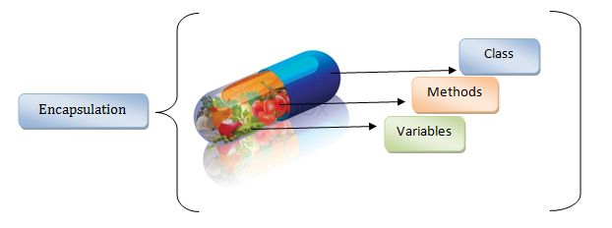
Encapsulation

Slide 4
Encapsulation
Definition: Unification/merging of attributes and methods of an object into a whole Restrict direct access to components of an object

Slide 5
Purpose of Encapsulation
Concealment of the internal structure of an information hiding/data hiding object Protects attributes from random changes outside of the class. Attributes can be made read-only or write-only Simplify the implementation of changes to requirements Makes system unit testing easier

Slide 6
Encapsulation Mechanism
Set access level modifiers to private so they can't be accessed directly outside of the class Provide getters and setters as a way to access or modify private attributes

Slide 7
Access Level Modifier
4 Access Level modifiers for attributes and methods:
public, protected, no modifier, private 2 access level modifier for class: public and no modifier

Slide 8
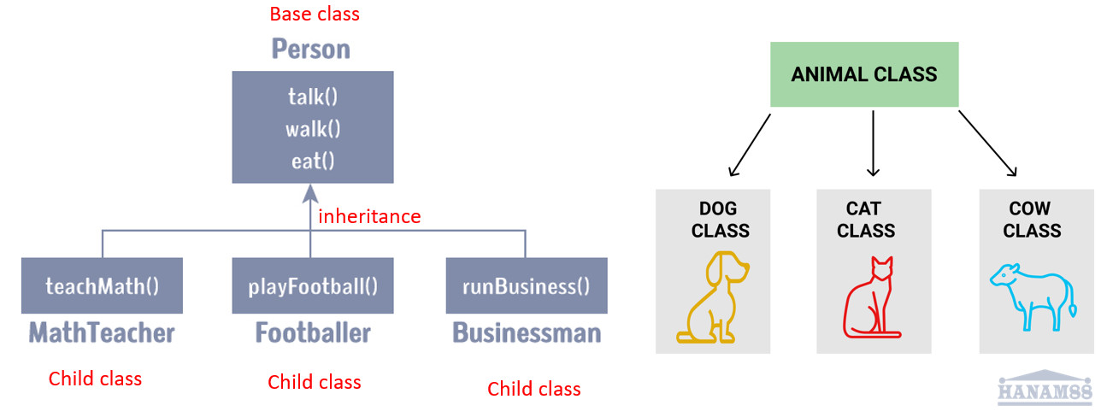
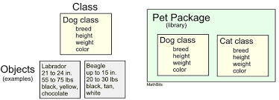
Access Level Modifier
There are 4 access level modifiers, namely: public – can be accessed from anywhere protected – can be accessed outside of the original package as a subclass (inherit to the class) No modifier (package-private) – can only be accessed within the same package Private – can only be accessed within the same class

Slide 9
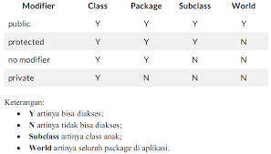
Access Modifier
Modifier | Class | Package | Subclass | Outside Package
public | v | v | v | v
protected | v | v | v
no modifier | v | v
private | v

Slide 10
Setter and Getter
Getter Public method that returns the value of the private attribute There is a return value
Setter Public methods that function to manipulate the value of private attributes No return value

Slide 11
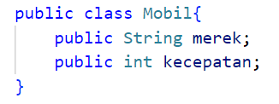
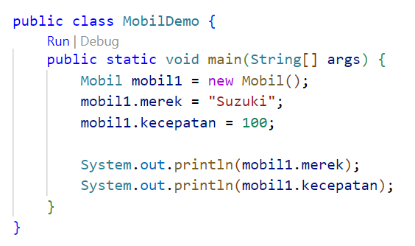
No Encapsulation

Slide 12
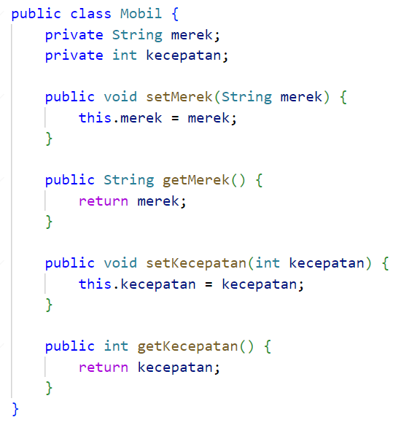
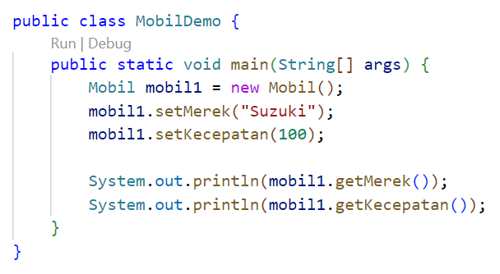
With Encapsulation
memanipulasi nilai dari atribut private, tidak ada return
mengembalikan nilai dari atribut private, ada return
mengeliminasi kebingungan antara atribut dan parameter dengan nama yang sama

Slide 13
this keyword
Keyword this refers to the current object This keyword is usually used to eliminate confusion between attributes and parameters with the same name

Slide 14
Read-Only & Write-Only Attribute
Read-only attribute → only has getters, but doesn't have setters
Write-only attribute → only has a setter, but doesn't have a getter

Slide 15
Notation in UML Class Diagram
The notation of the access level modifier in the UML class diagram is as follows: The plus sign (+) for public Hashtags (#) for protected Minus sign (-) for private For no-modifiers not given notation

Slide 16
Notation in UML Class Diagram
Anggota
- name: String - address: String
+ getName(): String + setName(newName: String): void + getAddress(): String + setAddress(newAddress: String): void

Slide 17
Assignment
In the previous task, modify the 1 diagram classes only, complete it with Notation modifiers and provide an explanation of the reason for the access

